Slide 1

6th Grade Math
Unit 12, Lesson 13 Writing and Solving One-Step Equations in One Variable Volume 2, pg. 350

Slide 2


Benchmarks
MA.6.AR.2.2
Write and solve one-step equations in one variable within a mathematical or real-world context using addition and subtraction, where all terms and solutions are integers.
MA.6.AR.2.3
Write and solve one-step equations in one variable within a mathematical or real-world context using multiplication and division, where all terms and solutions are integers.
volume 2, pg. 350

Slide 3
Integrated Mathematical Thinking and Reasoning Standards
MA.K12.MTR.1.1 Actively participate in effortful learning both individually and collectively.
MA.K12.MTR.2.1 Demonstrate understanding by representing problems in multiple ways.
MA.K12.MTR.4.1 Engage in discussions that reflect on the mathematical thinking of self and others.
MA.K12.MTR.5.1 Use patterns and structure to help understand and connect mathematical concepts.
MA.K12.MTR.6.1 Assess the reasonableness of solutions.
MA.K12.MTR.7.1 Apply mathematics to real-world contexts.
volume 2, pg. 350

Slide 4

Learning Targets
I can write and solve one-step equations in one variable within a real-world context using multiplication and division.
I can solve one-step equations in one variable using addition and subtraction.
volume 2, pg. 350

Slide 5

Warm-Up
volume 2, pg. 351

Slide 6
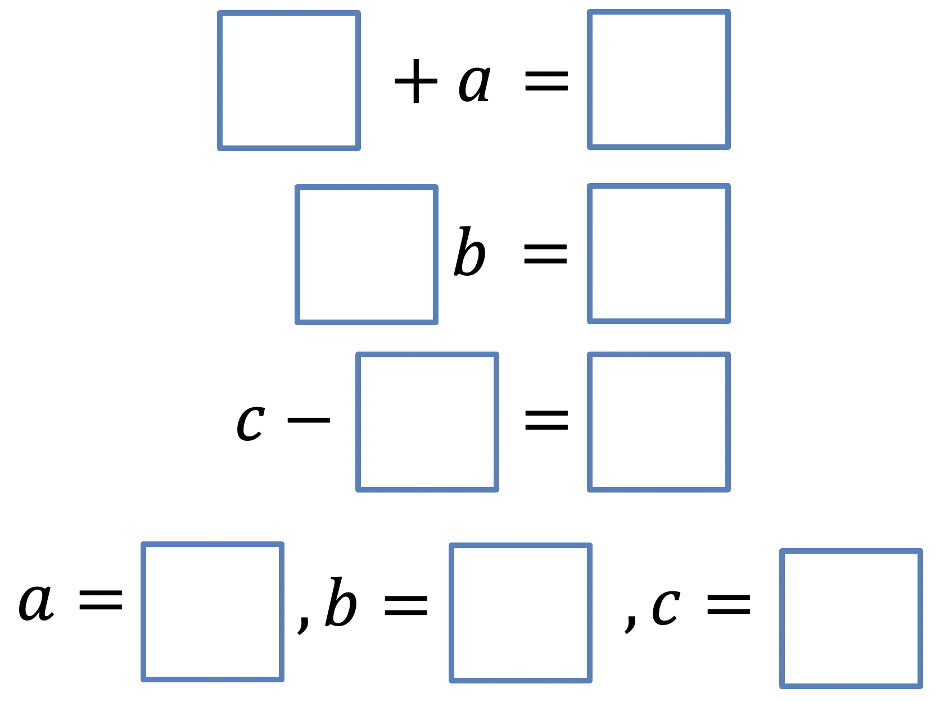
12.13.1 Warm-Up: One-Step Equations
volume 2, pg. 351

Slide 7

Collaboration
volume 2, pg. 351

Slide 8
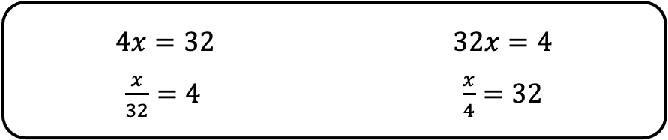
12.13.2 Collaboration: Relating Real-World Contexts to Equations
Four equations are shown.
Discuss with your partner which of the equations correctly represents each situation below, where 𝑥 represents the unknown quantity. Then, write the matching equation in the space provided.
volume 2, pg. 351

Slide 9
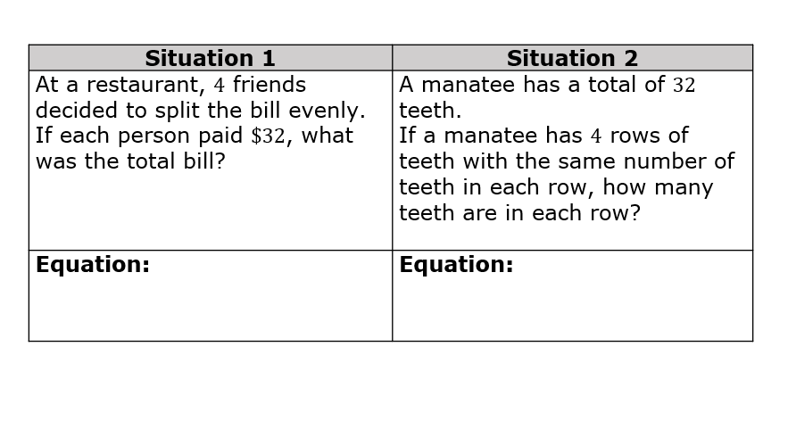
volume 2, pg. 351

Slide 10

Guided Instruction
volume 2, pg. 352

Slide 11
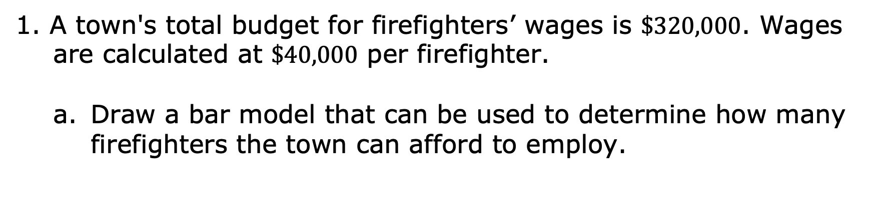
12.13.3 Guided Instruction: Solving One-Step Equations Representing Real-World Contexts Using Multiplication and Division
volume 2, pg. 352

Slide 12
Write an equation that can be used to find 𝑤, the number of firefighters the town can employ.
What is the value of 𝑤?
Explain what the solution means in the context of the problem.
volume 2, pg. 352

Slide 13
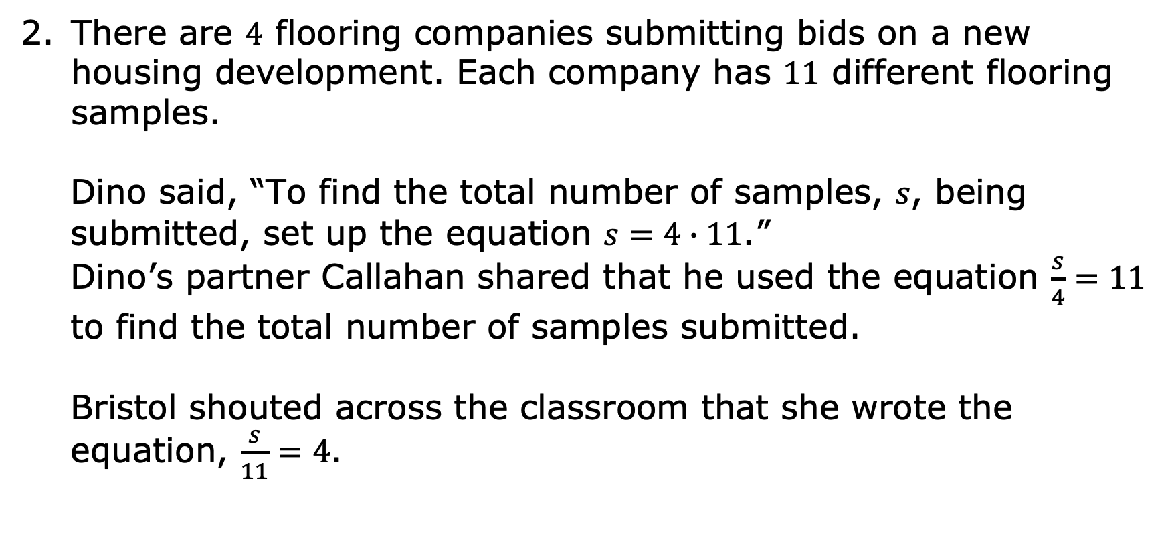
volume 2, pg. 352

Slide 14
Discuss with your partner which student — Dino, Callahan, or Bristol — wrote the correct equation to solve for the total number of samples submitted.
Solve one of the equations and then use a different equation to check your work.
Explain how the answer makes sense in terms of the context.
volume 2, pg. 352

Slide 15

Guided Practice
volume 2, pg. 353

Slide 16
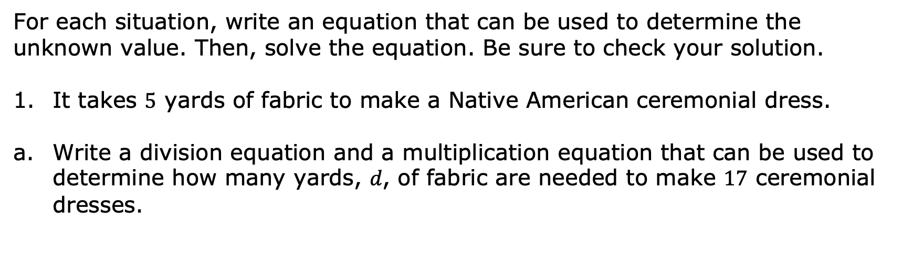
12.13.4 Guided Practice: Solving Multiplication and Division Equations for Real-World Contexts
Division Equation | Multiplication Equation
volume 2, pg. 353

Slide 17
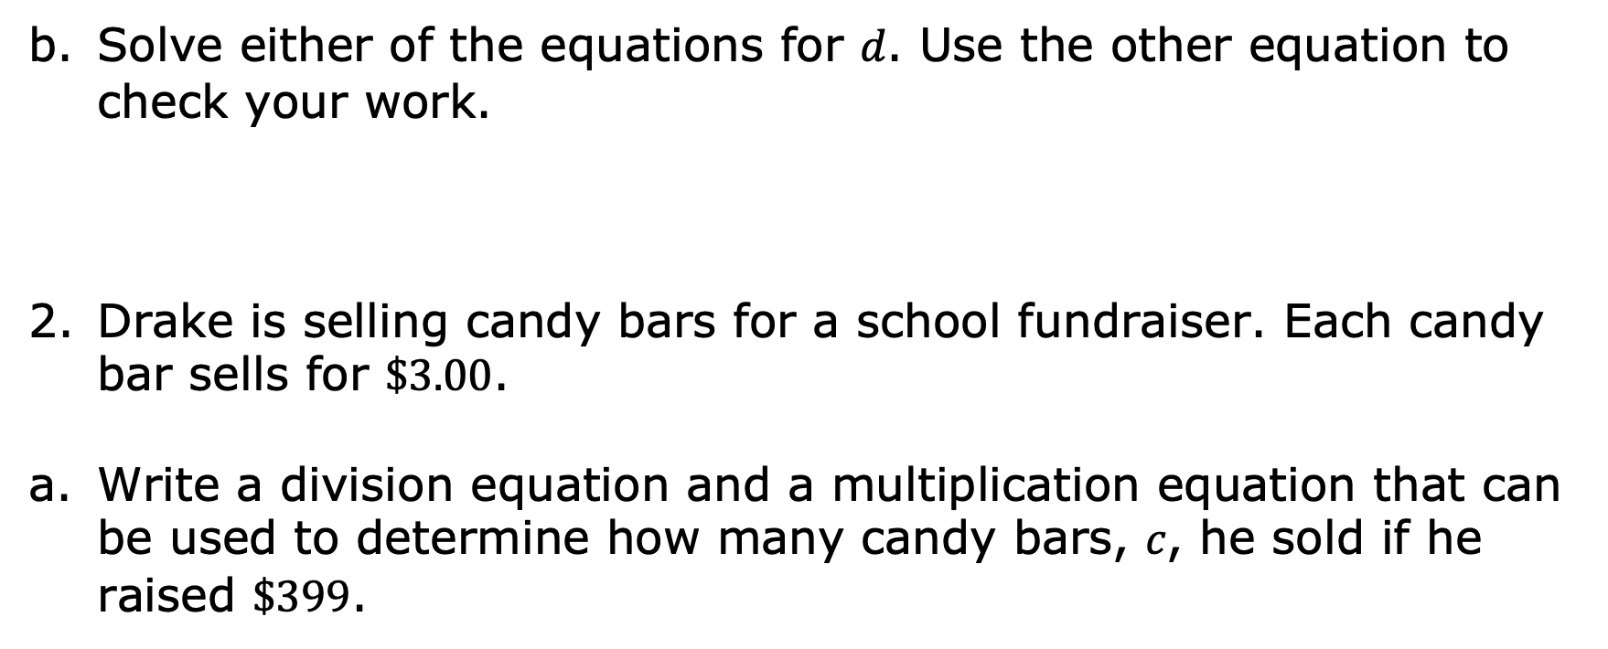
Division Equation | Multiplication Equation
volume 2, pg. 353

Slide 18
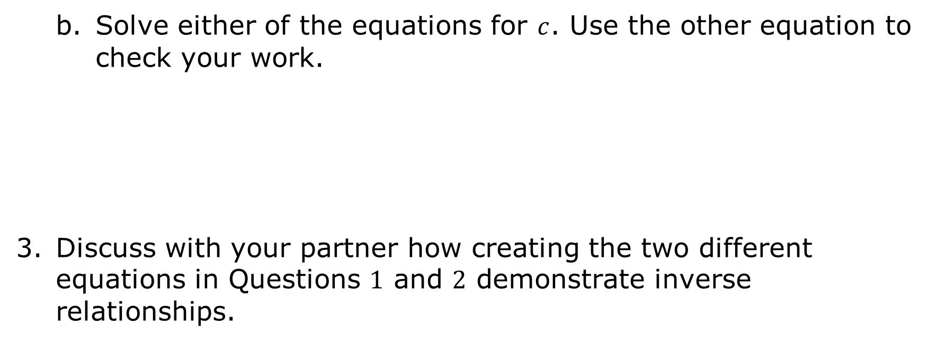
volume 2, pg. 353

Slide 19

Try It
volume 2, pg. 354

Slide 20
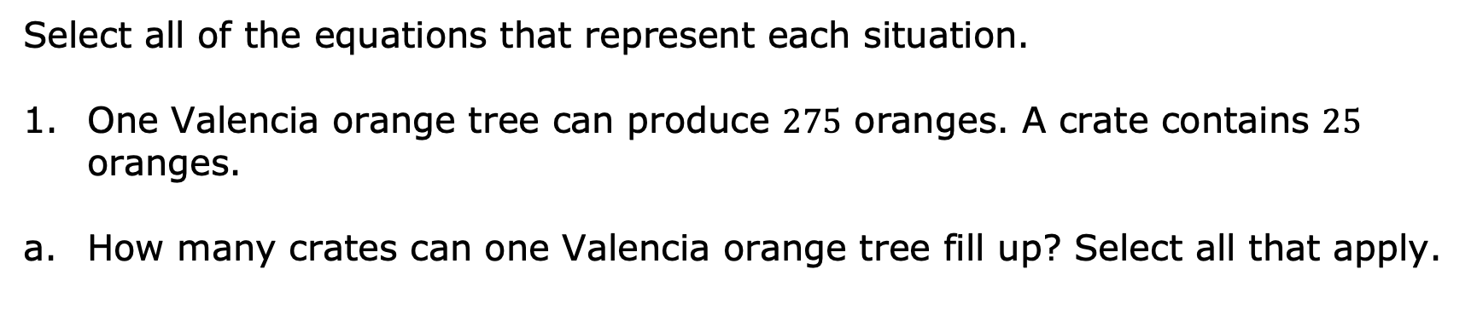
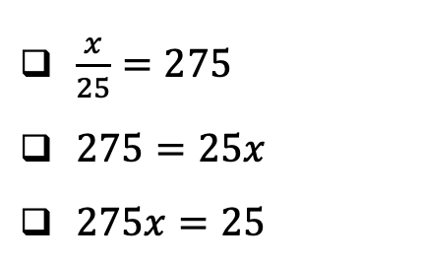
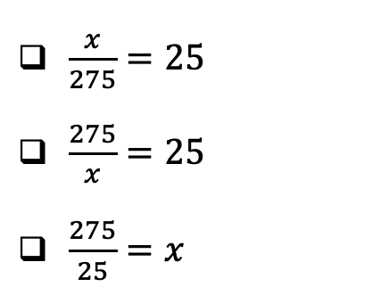
12.13.5 Try It: Mixed Review
volume 2, pg. 354

Slide 21
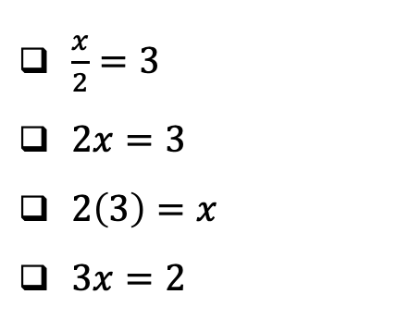
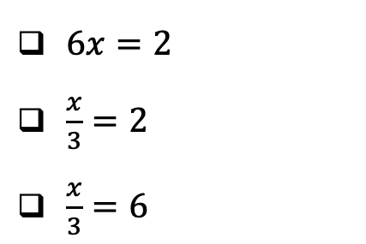
Pick one of the equations you selected and solve the problem. Show your reasoning.
Aliyah and Tiana want to bake 3 carrot cakes. Each carrot cake needs 2 cups of salted butter.
How much butter will they need to bake all 3 cakes? Select all that apply.
volume 2, pg. 354

Slide 22
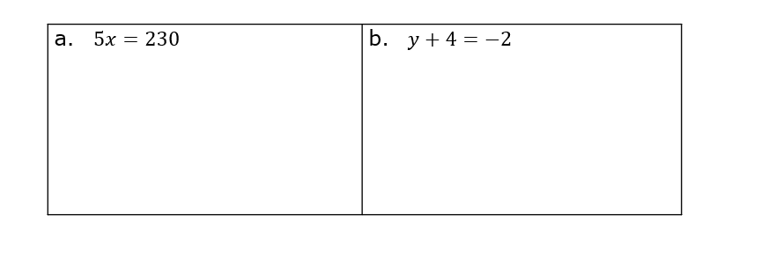
Select one of the equations you selected and solve the problem. Show your reasoning.
Solve each equation for the variable. Verify your answers.
volume 2, pg. 354

Slide 23
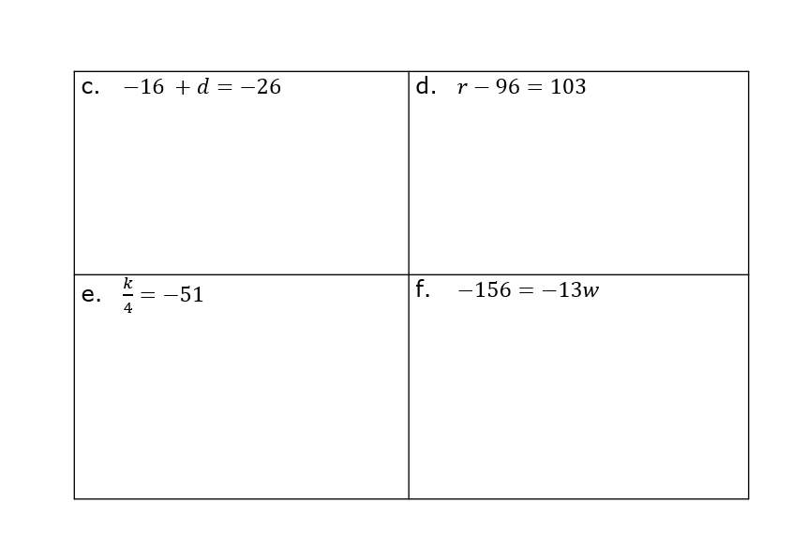
volume 2, pg. 354

Slide 24

Wrap-Up
volume 2, pg. 355

Slide 25
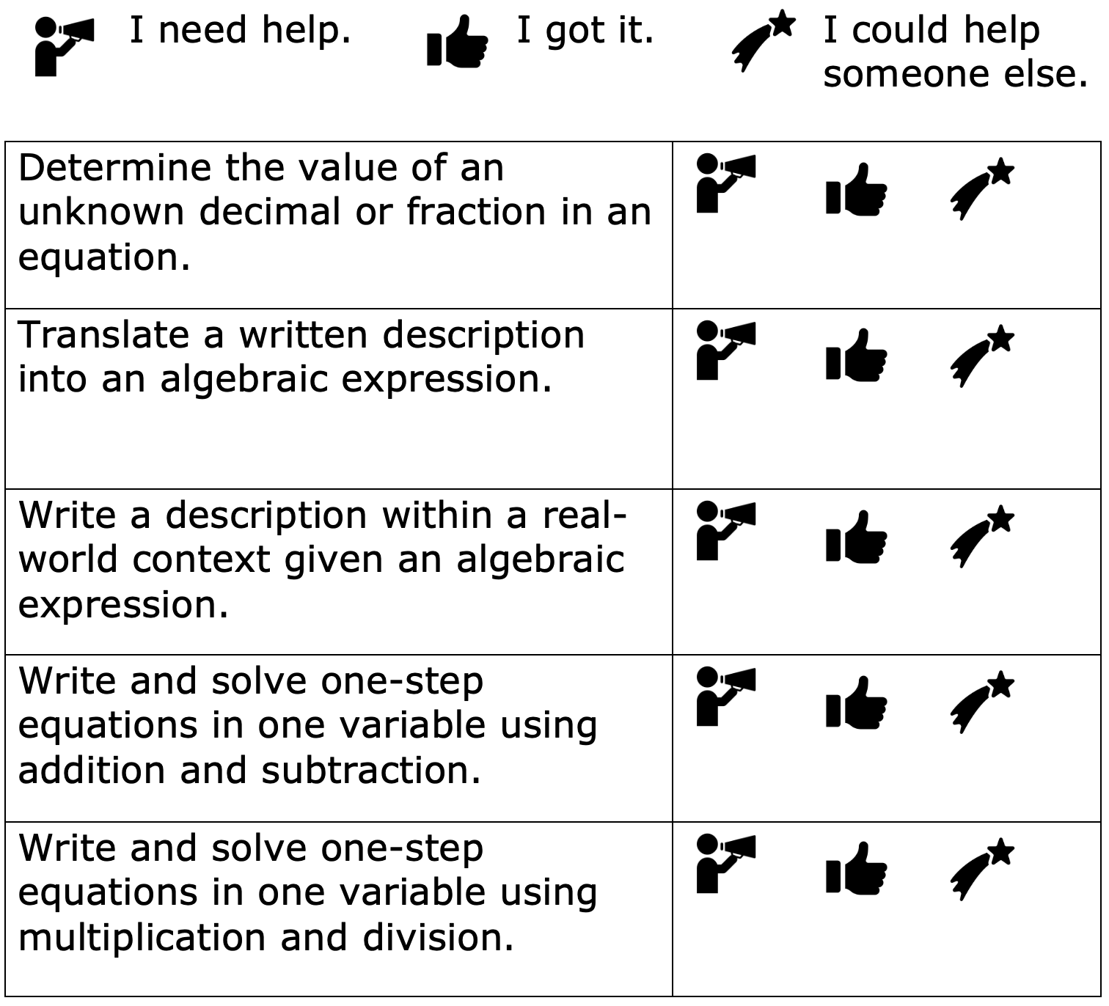
12.13.6 Wrap-Up: Reflection
Circle the icon that best describes your understanding of each learning objective.
volume 2, pg. 355

